Slide 1
Fuzzy Expert System for
Diagnosis of Diabetes Mellitus
Name : Chamani Shiranthika
Student Id : 710882702
1

Slide 2
Research Background
Diabetes is worldwide problem
Organic process in which the person has increase blood glucose
Increased due to infrequent western food habits or lacking exercise
Type 1, Type 2
Neural Network, Naïve Bayes, and Support vector machine implementations
2

Slide 3
Fuzzy Logic
Approach
3

Slide 4
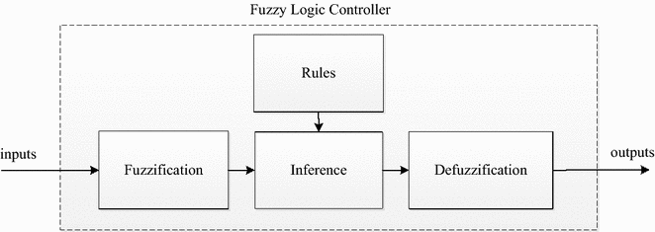
Fuzzy Logic
A precise problem-solving methodology
Expressing knowledge in a linguistic way
A mathematical tool for dealing with the uncertainty
Fuzzy
Logic
Simple, Human-friendly rules
Statement can assume any real value between 0 and 1
.
.
Used in many diagnosis software approaches
4

Slide 5
Fuzzy Logic Controller
Basic Design
Rules
Knowledge Base
Fuzzification
Inference
Engine
Defuzzification
Crisp Inputs
Crisp Outputs
5

Slide 6
Initialization
Linguistic variables and terms
Membership functions
Fuzzy
Logic
Steps
Fuzzification
.
Crisp input data to fuzzy values
Fuzzy inference
Evaluate rules
Defuzzification
Output fuzzy values to real values
6

Slide 7
Proposed
System
7

Slide 8
Input and output parameters
Inputs
Output
Pregnant times (Preg)
Glucose level (Plas)
Diastolic BP (Dias)
Skin Thickness (Tric)
Serum Insulin (Ins)
BMI (Mass)
Pedigree (Pedi)
Age (Age)
Diabetes Mellitus (DM)
8

Slide 9
Proposed Algorithm
Input : Input fuzzy set for A1, A2, A3, A4, A5, A6, A7 and A8
Output : Output fuzzy set for DM
Method
Begin
Step 1: Input the crisp values for A1, A2, A3, A4, A5, A6, A7 and A8. Step 2: Set the triangular membership function for the fuzzy number with equation. Step 3: Build the fuzzy numbers for A1, A2, A3, A4, A5, A6, A7 and A8 for input set Step 3.1: Build the fuzzy number for DM for the output set. Step 4: Fuzzy inference is executed by Mamdani’s method. Step 4.1: Input the rule as {Rule 1,2...k} Step 4.2: Matching degree of rule with OR fuzzy disjunction are calculated for fuzzy input set (A11, A12, A13, A21, A22, A23, A31, A32, A33, A41, A42, A43, A51, A52, A53, A61, A62, A63, A71, A72, A73, A81, A82, A83, DM1, DM2 and DM3).
Step 5: Defuzzify into the crisp values using centroid method Step 6: Present the knowledge in the form of human nature language. End.
Safe level
Medium level
Dangerous level
You can simply impress your audience and add a unique zing and appeal to your Presentations. Easy to change colors, photos and Text. I hope and I believe that this Template will your Time, Money and Reputation.
9

Slide 10
Fuzzy Variables | Representation of fuzzy | Fuzzy Numbers | Representation of fuzzy numbers | Fuzzy Triangular and Trapezoidal numbers
Pregnant times | A1 | Low | A11 | [0 0.475 7.213 7.213]
(Preg) |  | Medium | A12 | [0.475 7.213 12.1]
 |  | High | A13 | [7.213 12.1 17 17]
Glucose level | A2 | Low | A21 | [0 88.84 152.6 152.6]
(Plas) |  | Medium | A22 | [88.84 152.6 175.8]
 |  | High | A23 | [152.6 175.8 199 199]
Diastolic BP | A3 | Low | A31 | [0 49.73 88.44 88.44]
(Dias) |  | Medium | A32 | [49.73 88.44 105.2]
 |  | High | A33 | [88.44 105.2 122 122]
Skin Thickness | A4 | Good | A41 | [0 4.584 36.49 36.49]
(Tric) |  | Average | A42 | [4.584 36.49 67.74]
 |  | Below | A43 | [36.49 67.74 99 99]
Serum Insulin | A5 | Low | A51 | [0 35.44 195 195]
(Ins) |  | Medium | A52 | [35.44 195 520.5]
 |  | High | A53 | [195 520.5 846 846]
BMI | A6 | Low | A61 | [0 24.11 39.87 39.87]
(Mass) |  | Medium | A62 | [24.11 39.87 53.49]
 |  | High | A63 | [39.87 53.49 67.1 67.1]
Pedigree | A7 | Low | A71 | [0 0.1405 0.8032 0.8032]
(Pedi) |  | Medium | A72 | [0.1405 0.8032 1.612]
 |  | High | A73 | [0.8032 1.612 2.42 2.42]
Age | A8 | Young | A81 | [0 21.48 45 45]
(Age) |  | Medium | A82 | [21.48 45 63]
 |  | Old | A83 | [45 63 81 81]
Diabetes Mellitus | DM | Dangerous | DM1 | [-0.4 0 0.4]
 |  | Medium | DM2 | [0.1 0.5 0.9]
 |  | Safe | DM3 | [0.6 1 1.4]
Inputs
Output
10

Slide 11
Proposed Fuzzy Rules
1. If (A1 is Low) or (A2 is Low) or (A3 is Low) or (A4 is Good) or (A5 is Low) or (A6 is Low) or (A7 is Low) or (A8 is Low) then (DM is Low) (1)
2. If (A1 is Medium) or (A2 is Medium) or (A3 is Medium) or (A4 is Average) or (A5 is Medium) or (A6 is Medium) or (A7 is Medium) or (A8 is Medium) then (DM is Medium) (1)
3. If (A1 is High) or (A2 is High) or (A3 is High) or (A4 is Below Average) or (A5 is High) or (A6 is High) or (A7 is High) or (A8 is High) then (DM is High) (1)
4. If (A1 is High) or (A2 is High) or (A3 is Medium) or (A4 is Below Average) or (A5 is High) or (A6 is High) or (A7 is High) or (A8 is High) then (DM is Medium) (1)
5. If (A1 is High) or (A2 is Medium) or (A3 is High) or (A4 is Below Average) or (A5 is High) or (A6 is High) or (A7 is High) or (A8 is High) then (DM is Medium) (1)
6. If (A1 is Low) or (A2 is High) or (A3 is High) or (A4 is Good) or (A5 is Low) or (A6 is Low) or (A7 is Low) or (A8 is Low) then (DM is Low) (1)
7. If (A1 is Low) or (A2 is High) or (A3 is Medium) or (A4 is Good) or (A5 is Low) or (A6 is Low) or (A7 is Low) or (A8 is Low) then (DM is Low) (1)
8. If (A1 is Low) or (A2 is Medium) or (A3 is High) or (A4 is Good) or (A5 is Low) or (A6 is Low) or (A7 is Low) or (A8 is Low) then (DM is Low) (1)
9. If (A1 is Medium) or (A2 is High) or (A3 is Medium) or (A4 is Average) or (A5 is Medium) or (A6 is Medium) or (A7 is Medium) or (A8 is Medium) then (DM is Medium) (1)
11

Slide 12
Proposed Fuzzy Rules
10. If (A1 is Medium) or (A2 is Medium) or (A3 is High) or (A4 is Average) or (A5 is Medium) or (A6 is Medium) or (A7 is Medium) or (A8 is Medium) then (DM is Medium) (1)
11. If (A1 is High) or (A2 is Medium) or (A3 is Medium) or (A4 is Average) or (A5 is Medium) or (A6 is Medium) or (A7 is Medium) or (A8 is Medium) then (DM is Medium) (1)
12. If (A1 is Medium) or (A2 is High) or (A3 is Medium) or (A4 is Average) or (A5 is Medium) or (A6 is Medium) or (A7 is Medium) or (A8 is Medium) then (DM is Medium) (1)
13. If (A1 is Medium) or (A2 is Medium) or (A3 is High) or (A4 is Average) or (A5 is Medium) or (A6 is Medium) or (A7 is Medium) or (A8 is Medium) then (DM is Medium) (1)
14. If (A1 is Medium) or (A2 is Medium) or (A3 is Medium) or (A4 is Below Average) or (A5 is Medium) or (A6 is Medium) or (A7 is Medium) or (A8 is Medium) then (DM is Medium) (1)
15. If (A1 is Medium) or (A2 is Medium) or (A3 is Medium) or (A4 is Average) or (A5 is High) or (A6 is Medium) or (A7 is Medium) or (A8 is Medium) then (DM is Medium) (1)
16. If (A1 is Medium) or (A2 is Medium) or (A3 is Medium) or (A4 is Average) or (A5 is Medium) or (A6 is High) or (A7 is Medium) or (A8 is Medium) then (DM is Medium) (1)
17. If (A1 is Medium) or (A2 is Medium) or (A3 is Medium) or (A4 is Average) or (A5 is Medium) or (A6 is Medium) or (A7 is High) or (A8 is Medium) then (DM is Medium) (1)
18. If (A1 is Medium) or (A2 is Medium) or (A3 is Medium) or (A4 is Average) or (A5 is Medium) or (A6 is Medium) or (A7 is Medium) or (A8 is Old) then (DM is Medium) (1)
12

Slide 13
Mamdani Method
AndMethod = 'min' OrMethod = 'max' ImpMethod = 'min' AggMethod = 'max' DefuzzMethod = ‘ centroid ’
[Input1] (Pregnant times) Name='Preg' Range=[0 17] NumMFs=3 MF1='Low':'trapmf',[0 0.475 7.213 7.213] MF2='Medium':'trimf',[0.475 7.213 12.1] MF3='High':'trimf',[7.213 12.1 17 17]
[Output] (Diabetes Mellitus) Name='output' Range=[0 1] NumMFs=3 MF1='Dangerous':'trimf',[-0.4 0 0.4] MF2='Medium':'trimf',[0.1 0.5 0.9] MF3='Safe':'trimf',[0.6 1 1.4]
13

Slide 14
Mamdani Method
Rule Structure:
OR Operation
1 3 1 2 1 1 3 1, 3 (1) : 2
If
Pregnant times is low or
Glucose level is high or
…..
…..
Age is young,
Then DM is safe
Weight assigned
8 Inputs
Output is the 3rd one
(MF3)
14

Slide 15
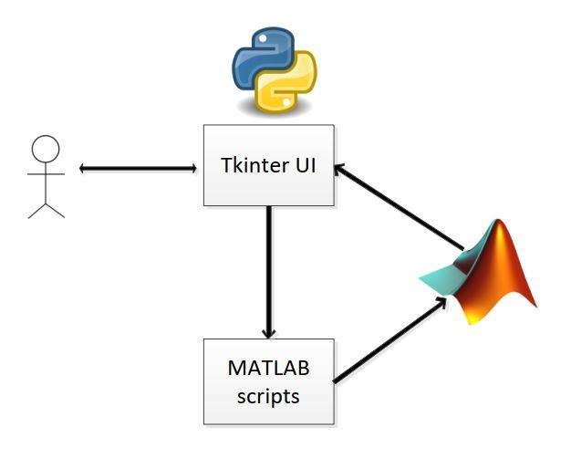
Implementation
Matlab Engine API
15

Slide 16
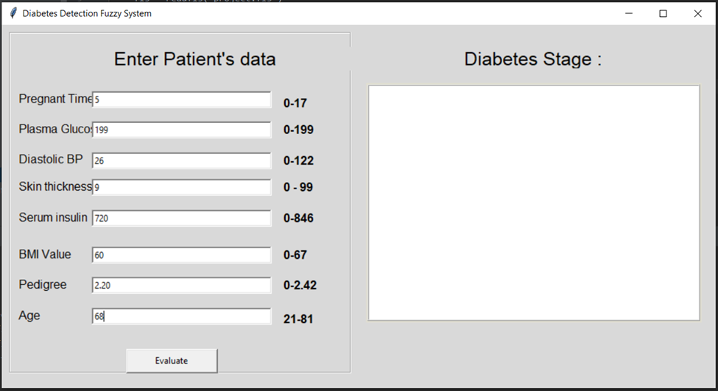
16

Slide 17
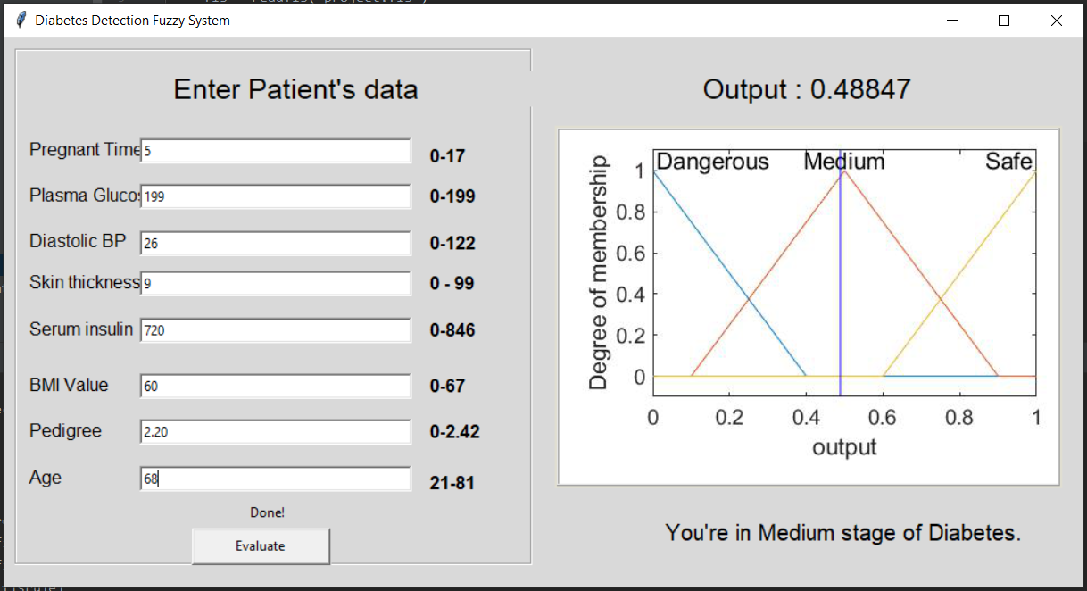
17

Slide 18

Evaluation of Results
Pima Indian’s
DB
Accuracy = TN + TP
TN + TP + FN + FP
True Positive (TP): Sick people correctly identified as sick
False Positive (FP): Healthy people incorrectly identified as sick
True Negative (TN): Healthy people correctly identified as healthy
False Negative (FN): Sick people incorrectly identified as healthy
 | Predicted : No | Predicted : Yes
Actual : No | TN = 22 | FP = 2
Actual : Yes | FN = 2 | TP = 24
92 %
18

Slide 19
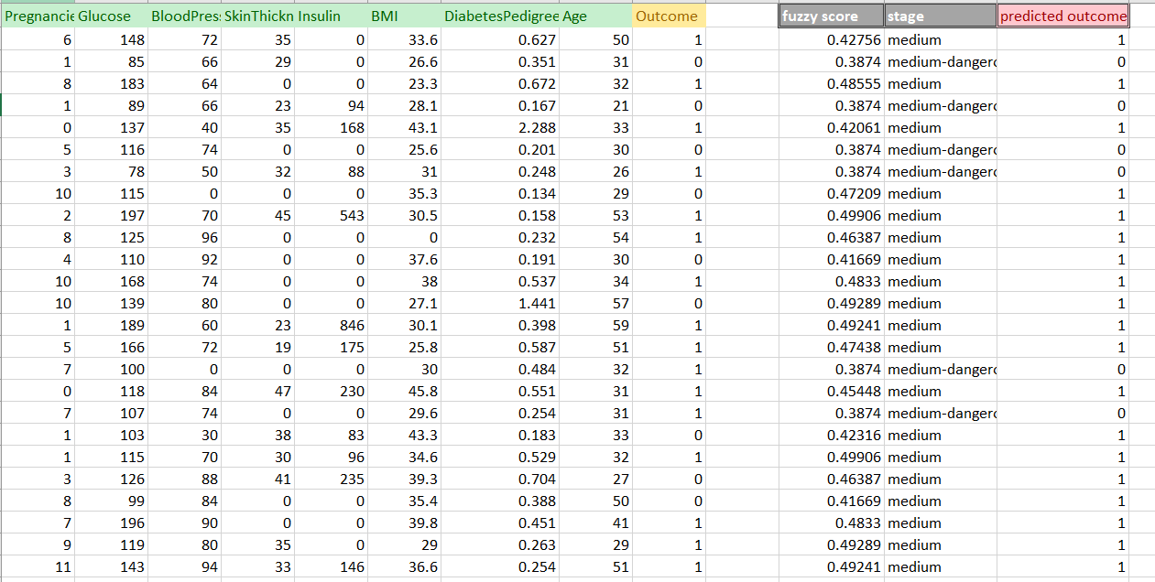

Pima Indian’s
DB
Proposed fuzzy System
19

Slide 20
Thank You
20

